Slide 1


Intelligent Reflective Surfaces (IRSs)
GARRETT FAIRBANKS – INDIANA UNIVERSITY
MENTOR – DR. REZA AMINEH

Slide 2



Overview
Background Information
Results and Quality
Improvements
Conclusions
Future Works

Slide 3
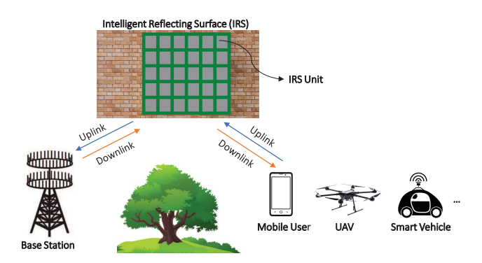
What is an Intelligent Reflective Surface (IRS)?
- A 2D surface usually containing multiple unit cells that all serve to “reflect” a wave past an obstacle or block it from passing a certain area or user without a connected power source.

Slide 4
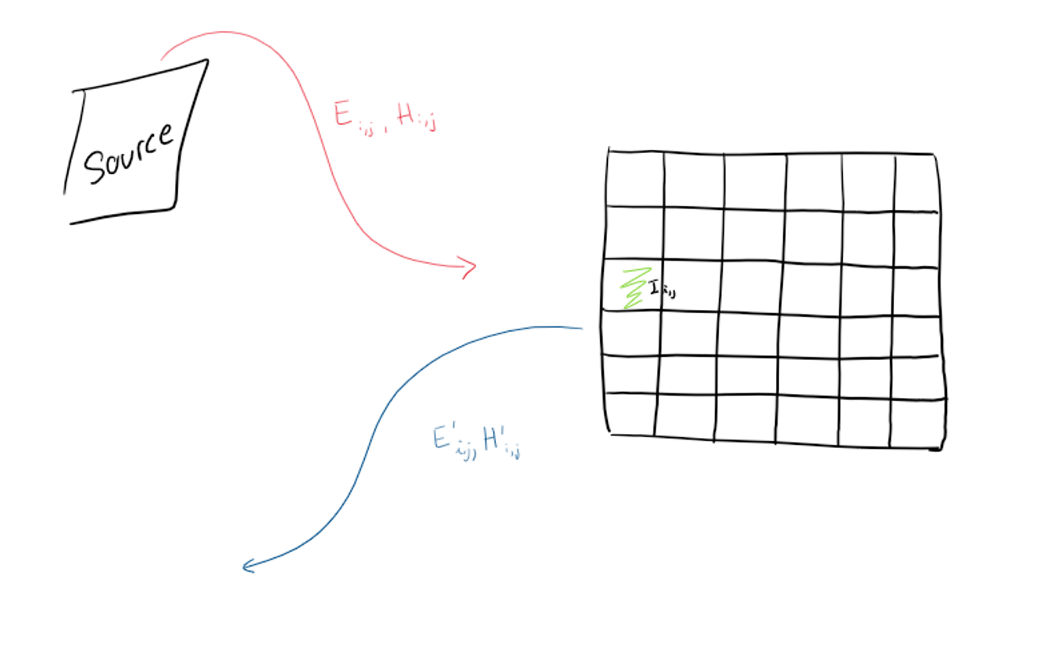
How does an IRS Work?
According to Maxwell's Equations:
Electromagnetic Radiation induces electric current in metal
Current induces a “reflected” magnetic field
Notes:
Change picture

Slide 5
My Involvement in the IRS Space
Implement a feasible model of an IRS system that can control a field distribution.
Must be able to control the output to an acceptable degree
Must quantize the level of magnitude and phase, and test accuracy.

Slide 6
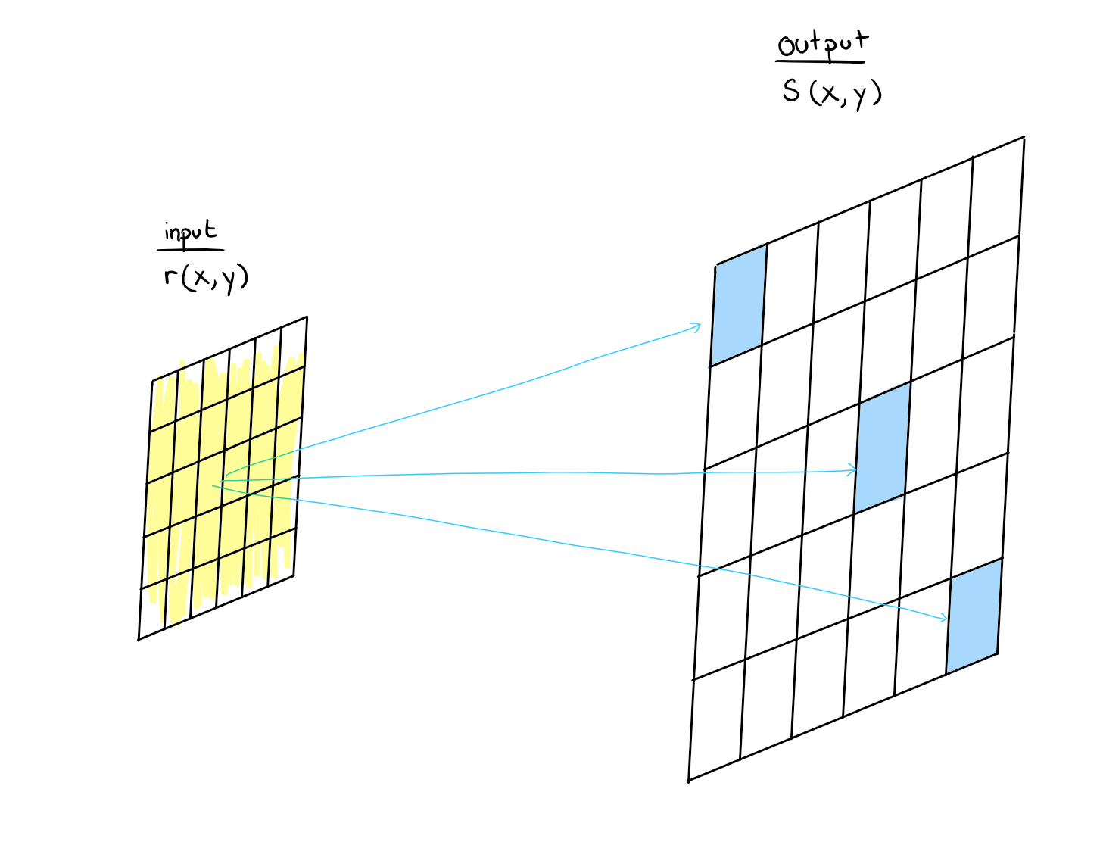
Functionality of IRS
r(x,y) = Incoming Wave onto the IRS
s(x,y) = Field Distribution of Observation Surface
IRS
Observation Surface

Slide 7

So, What is the Process?

Slide 8
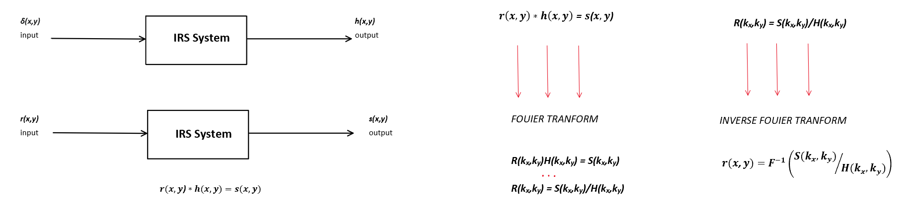
Process
i) ii) iii)

Slide 9
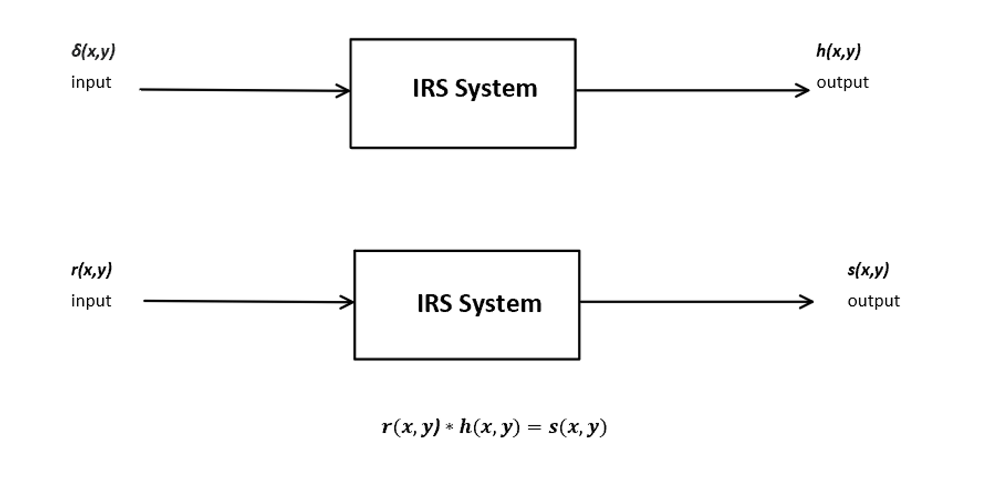
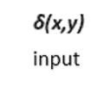
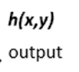
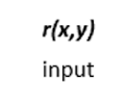
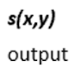
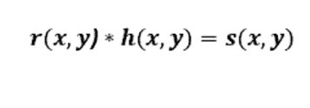
Interlude
Known Values
s(x,y) – Field Distribution
δ(x,y) – Delta Function
h(x,y) – Impulse Response
Unknown Values
r(x,y) – reflection
coefficient
Notes:
from signal processing in general into the IRS system

Slide 10
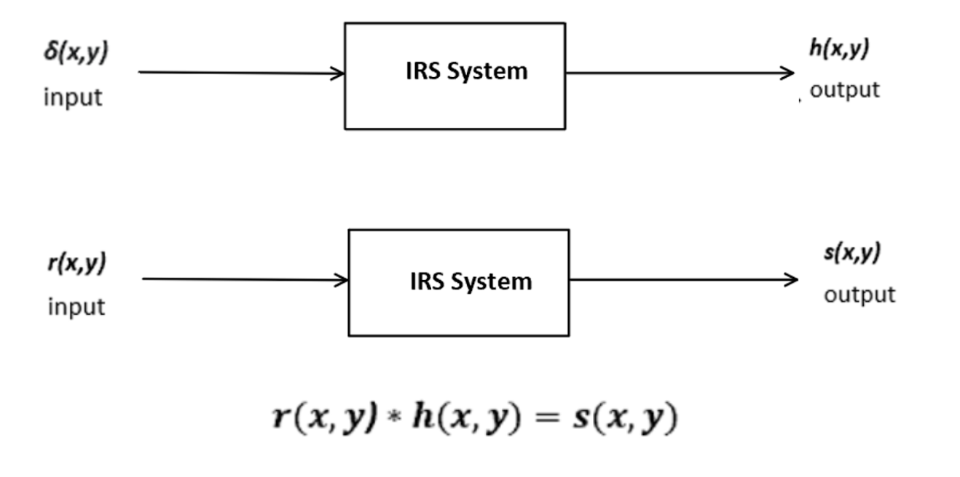
Step 1

Slide 11
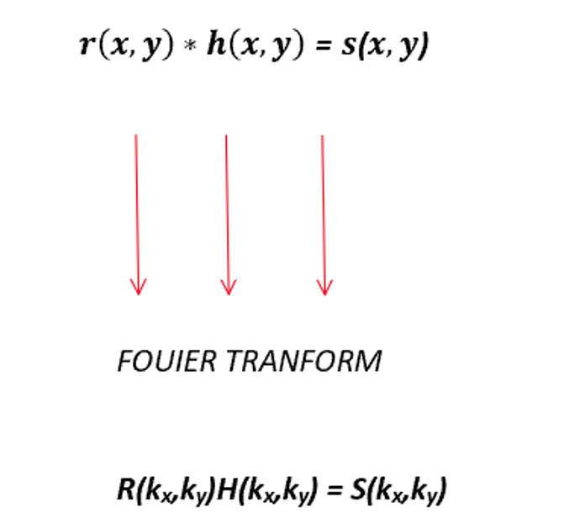
Step 2
Notes:
to simplify solving this problem we use fourier transform

Slide 12
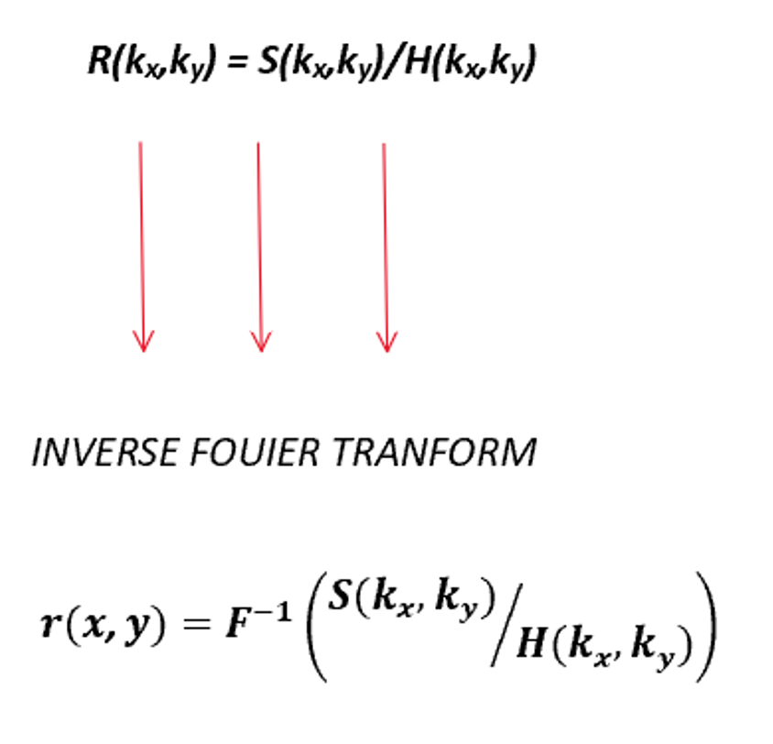
Step 3

Slide 13
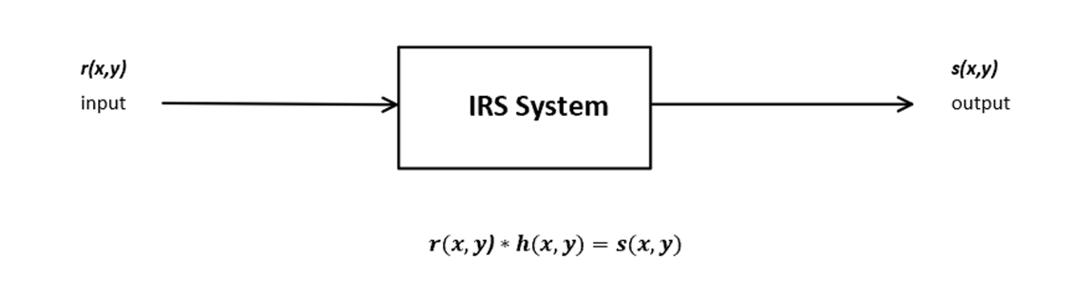
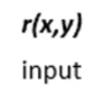
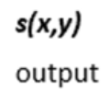

All There’s Left is to Check!!

Slide 14
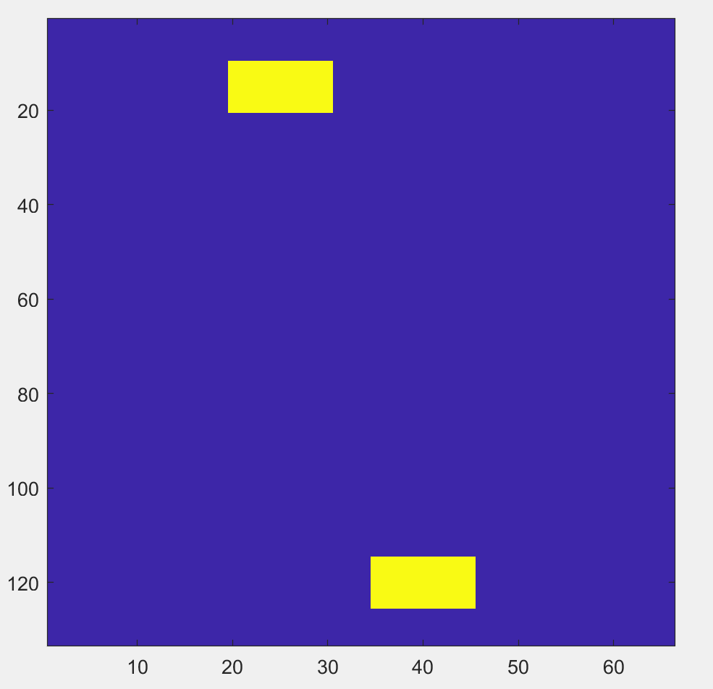
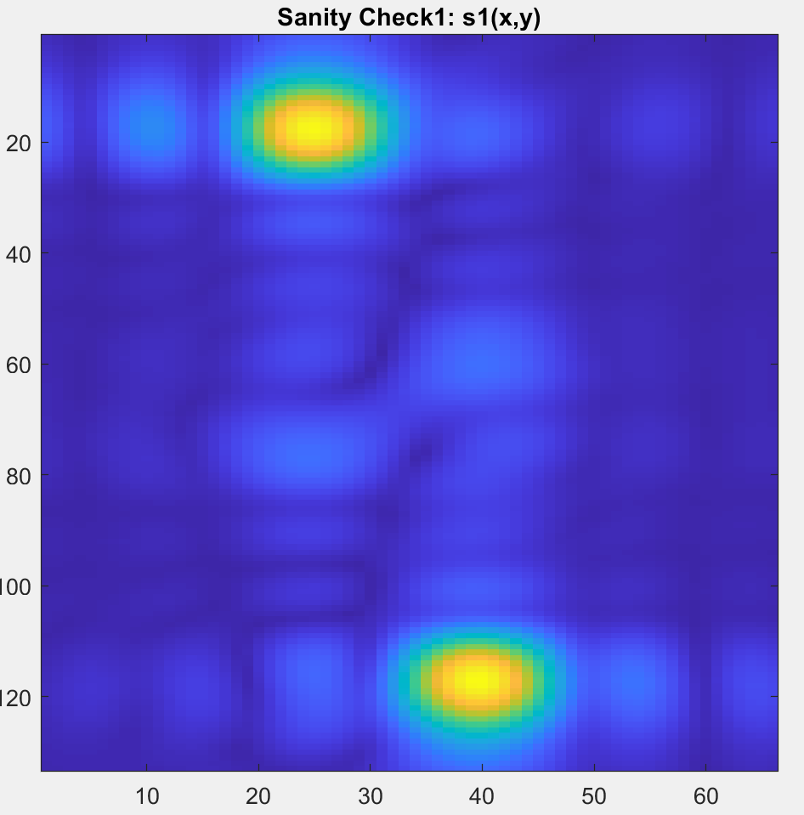

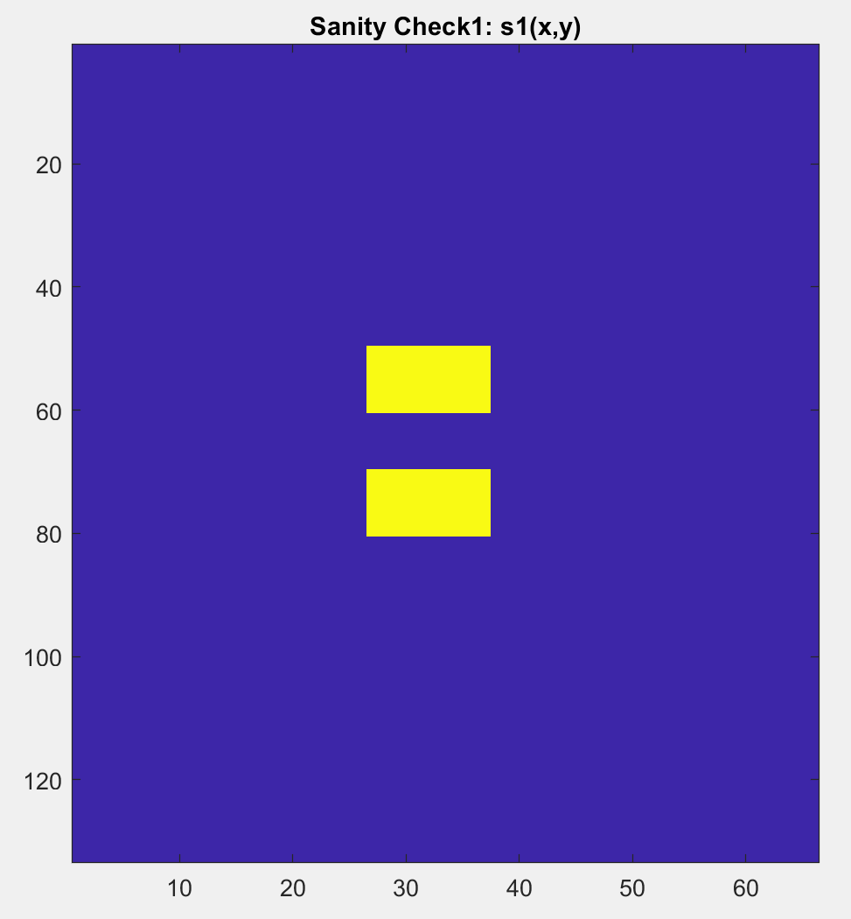
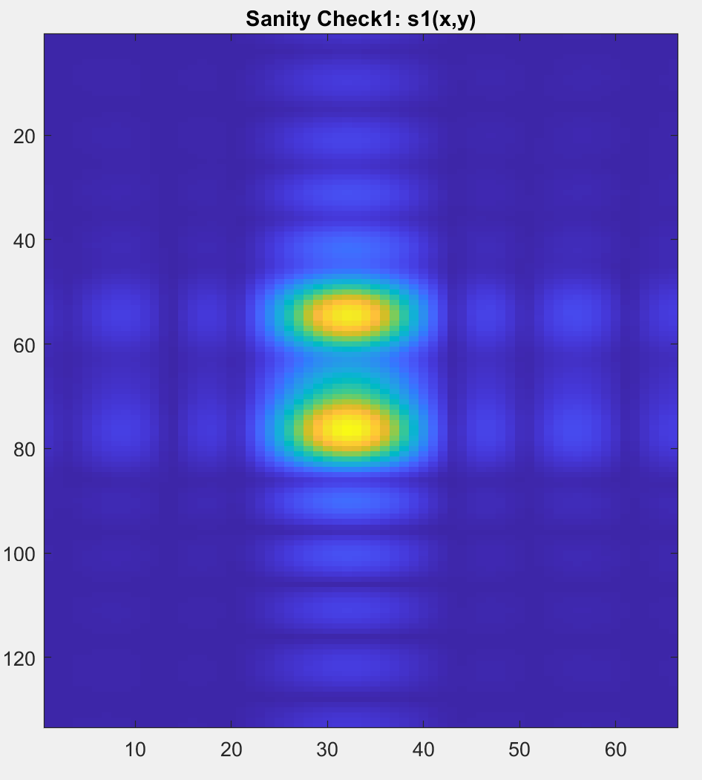
First Round of Results: Promising
Field Distribution to Replicate
Field Distribution Resulting of Process
Field Distribution to Replicate
Results of Process
Notes:
More descriptive names

Slide 15
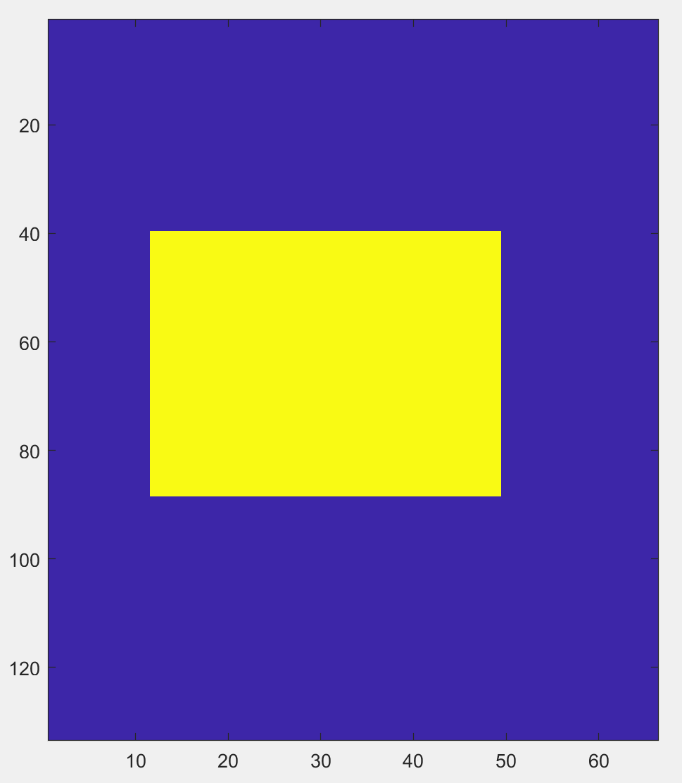
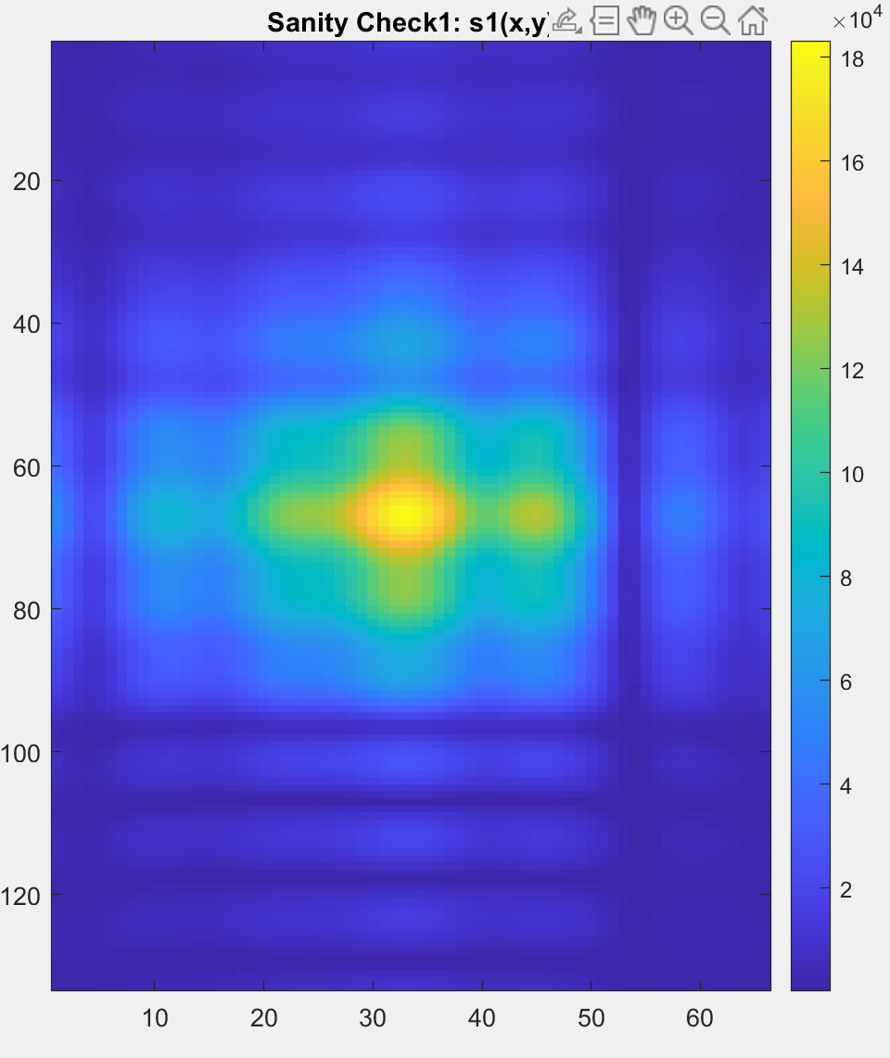
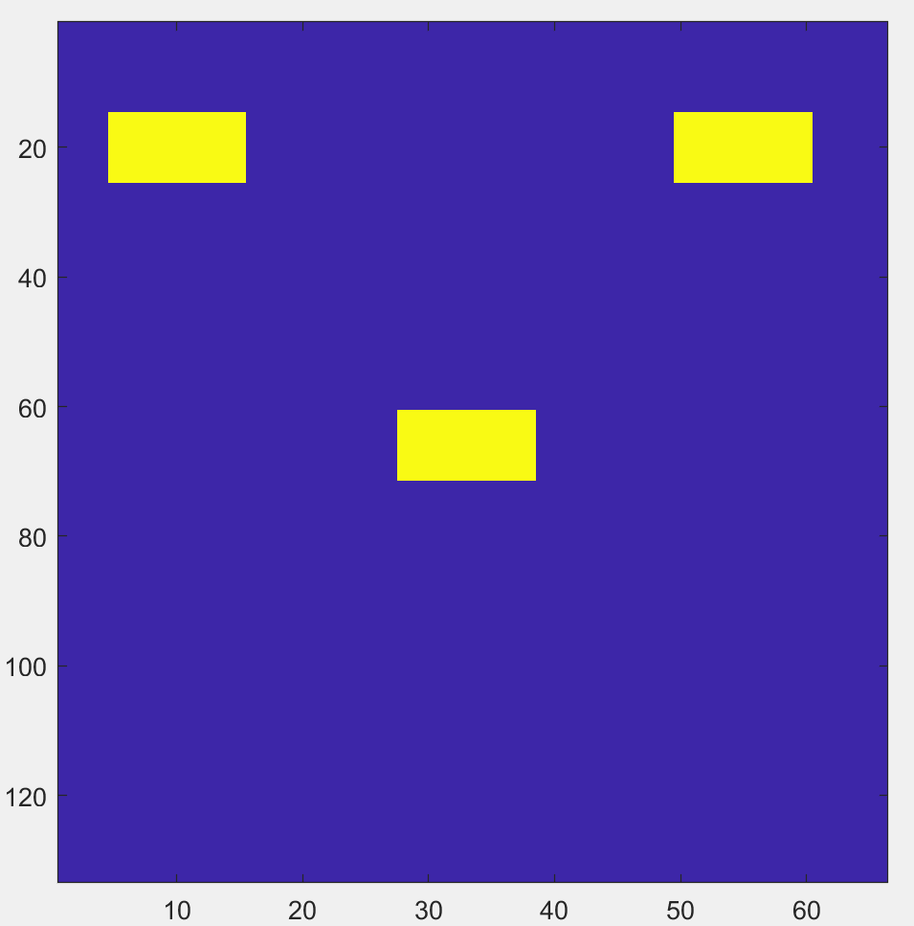
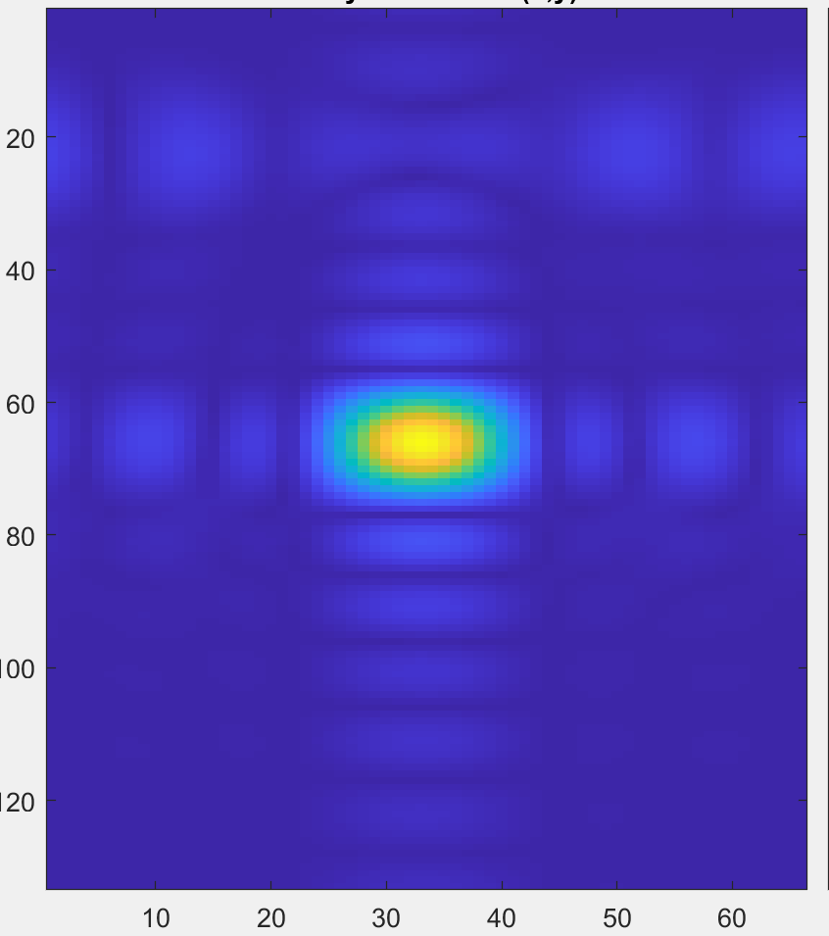
First Round of Results: Bad Batch
Results of Process
Want to Replicate
Results of Process
Want to Replicate

Slide 16
Improvements: Phase Iterating
- Currently The Field which we want to replicate has magnitude, but no phase associated.
- But we take the phase data from our field distribution and contribute it to the field we want to replicate

Slide 17
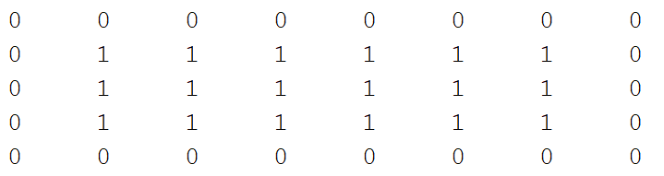
Improvements: Phase Iterating
Only Magnitude

Slide 18
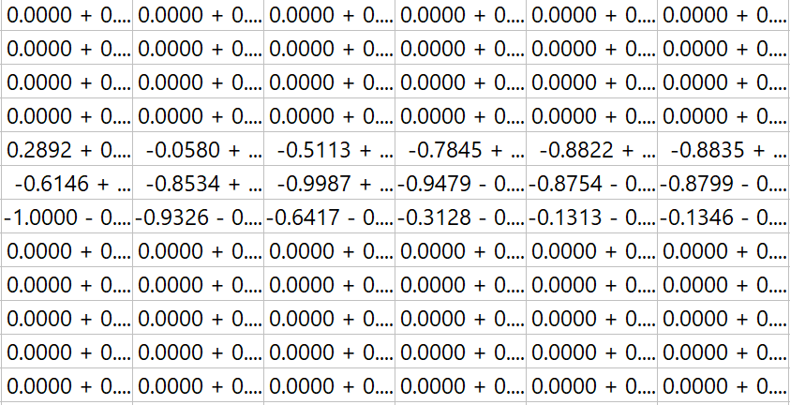
Improvements: Phase Iterating
Magnitude and Phase

Slide 19
Improvements: Phase Iterating
As stated before, the original distribution had no phase associated, but was added through a process. From this point the same process can be repeated for multiple iterations.
Thus, Phase Iterating

Slide 20
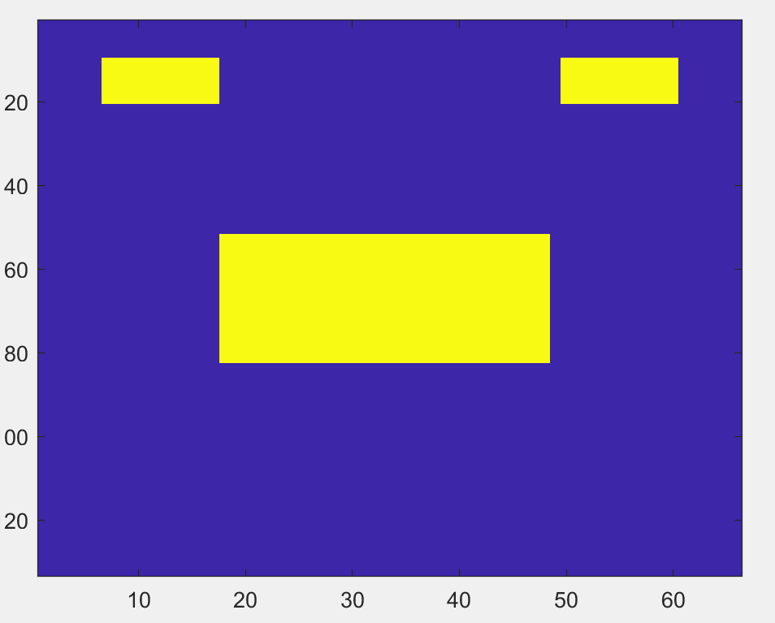
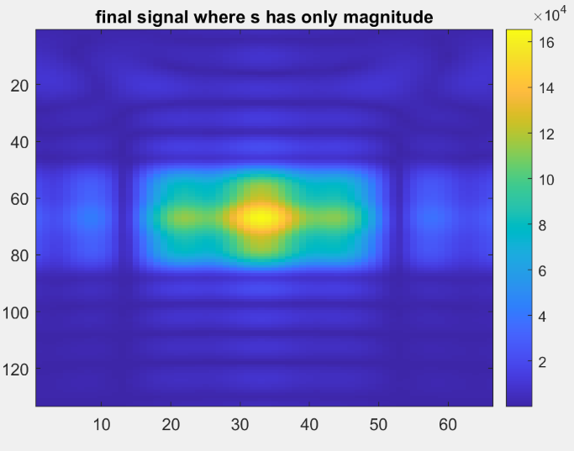
RESULTS
Distribution to replicate
Resulting Field: No Phase

Slide 21
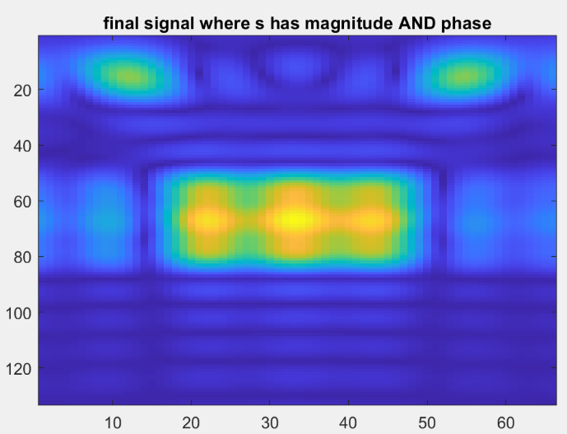
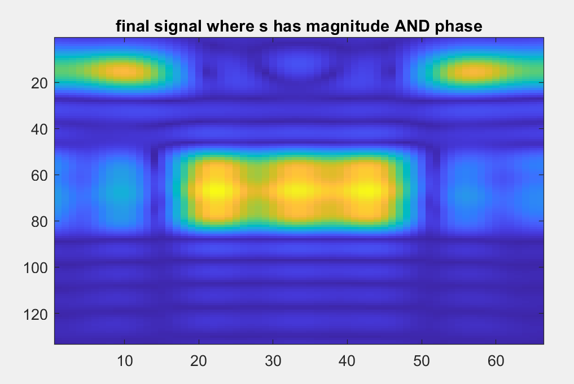
RESULTS
Magnitude and Phase
2 phase Iterations

Slide 22
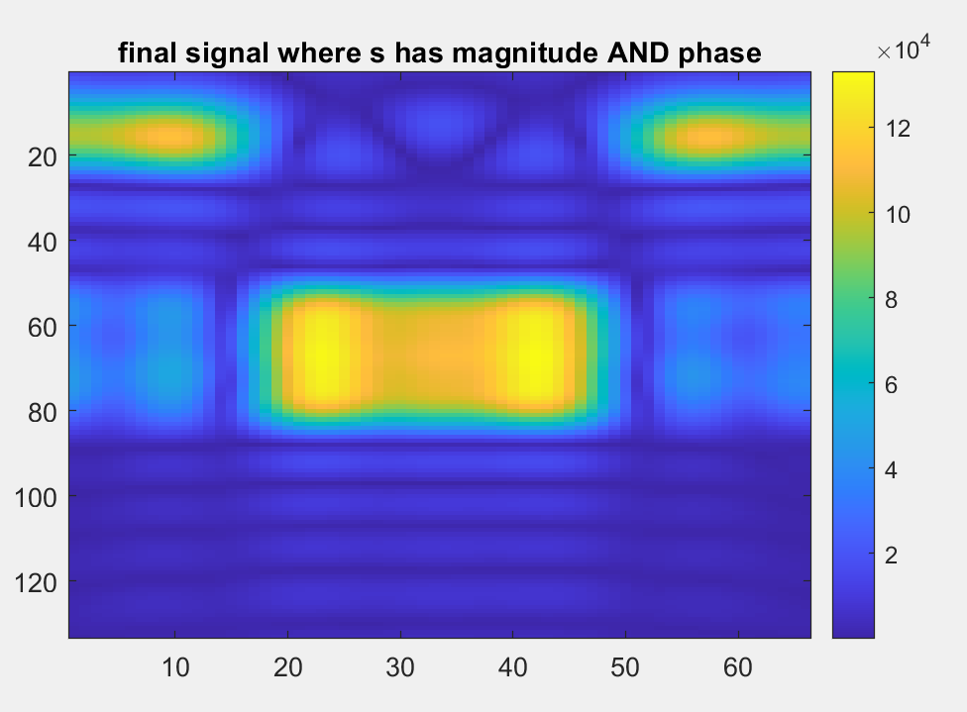
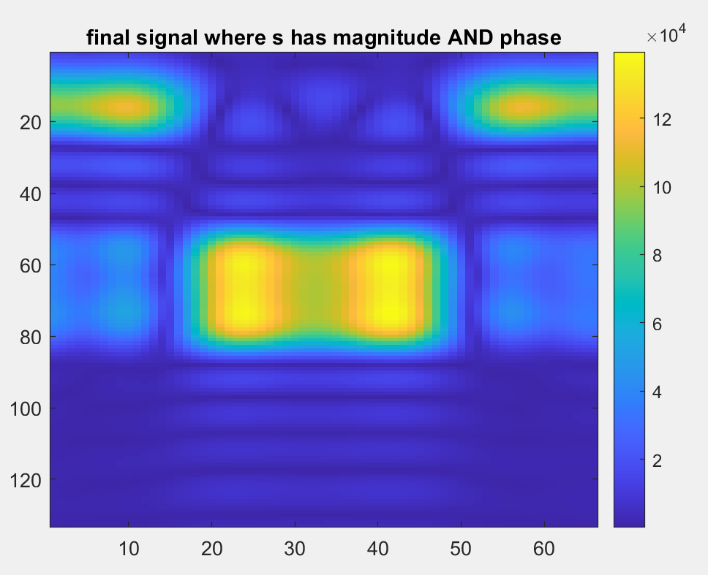
RESULTS
5 phase Iterations
10 phase Iterations

Slide 23
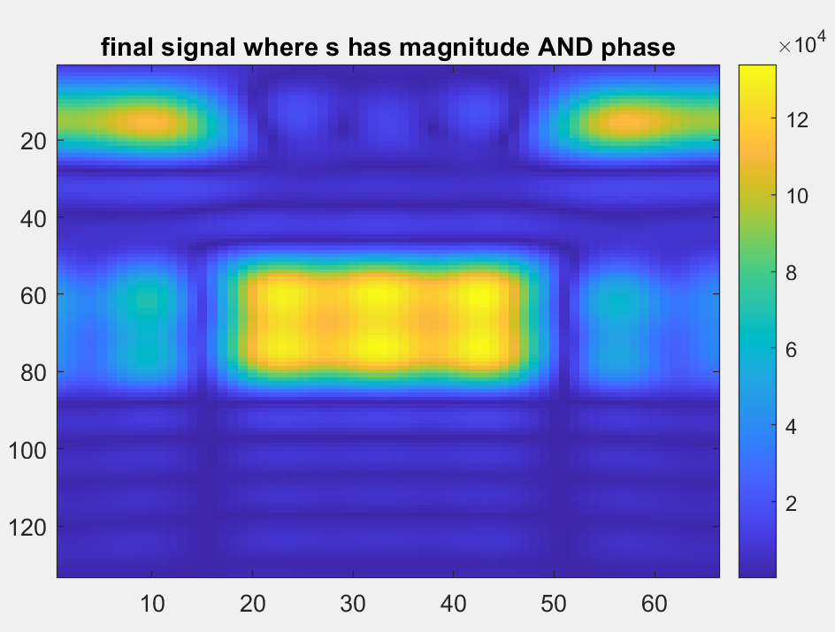
RESULTS
Resulting Field: No Phase
25 phase Iterations

Slide 24
Mag-Phase Quantizing
We cannot have an infinite amount of values for magnitude and phase due to the practical use of varactor nodes and digital to analog converters. It would be beneficial to know how well this system can replicate field distributions when phase as well as magnitude is quantized
This is where mag-phase quantization comes into play
Notes:
We cannot have any value for magnitude and phase since we will be using a DAC and varactor diode, we can only have a limited levels of phase and magnitude.

Slide 25
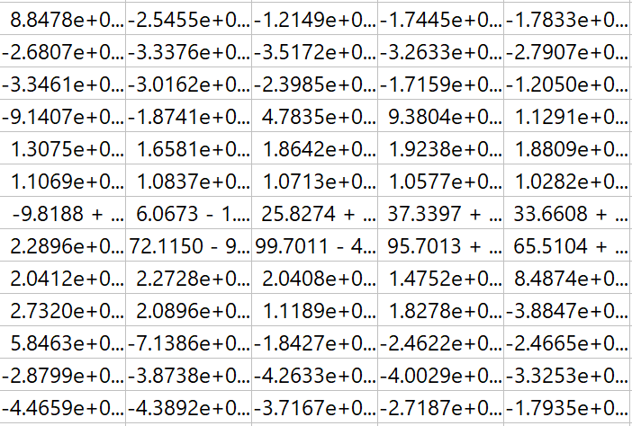
Example - No Mag-Phase Quantizing
Notes:
specify these are the reflection coefficients on the IRS surface

Slide 26
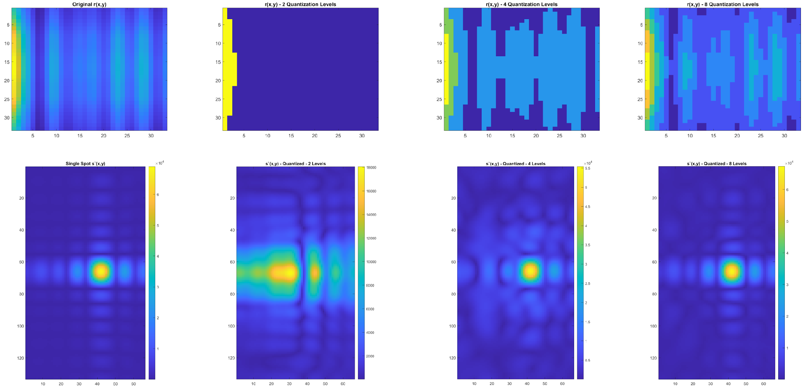
Results
Quantization Levels: None 2 4 8

Slide 27
Conclusions
There’s a certain iteration threshold such that performing more phase iterations would yield negligible improvements. This threshold can depend on position and size of the square “spots”(maxima of the field).
There also exists a quantization threshold, where you cannot quantize phase anymore without misrepresenting the field distribution.

Slide 28
Future Works and Studies
Improving Upon the model as it stands currently; i.e. better quantization threshold.
More iterations could be experimented with in the model.
Implementation of the model into the real world.
Experimentation with different sized IRS and Observation Surfaces.

Slide 29
Questions?
☺

